Slide 1
Algorithms Parallelization in ASIC Design
Relatori:
Prof. Mariagrazia Graziano
Prof. Marco Vacca
Prof. Maurizio Zambon
Candidato:
Jiang Gina

Slide 2
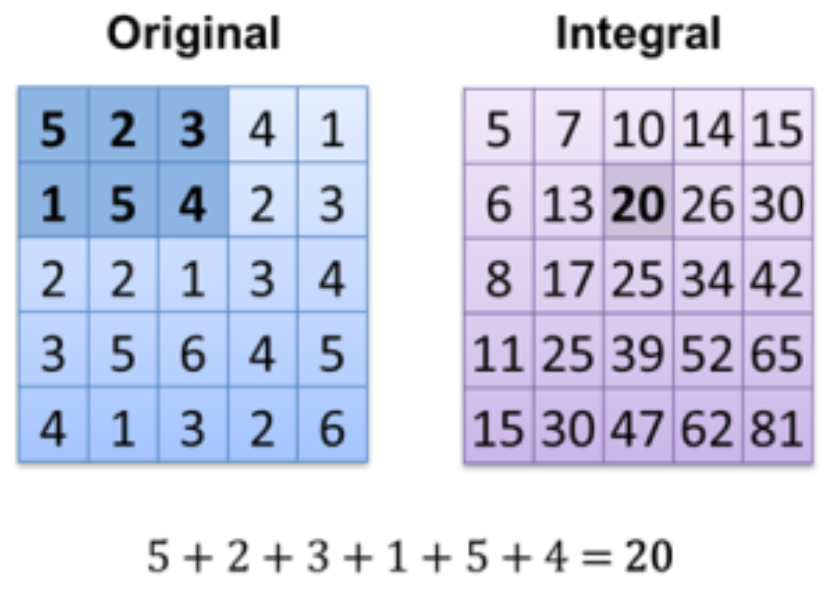
SUMMED AREA TABLE
Is an algorithm for quickly and eﬃciently generating the sum of values in a rectangular subset of a grid.

Slide 3
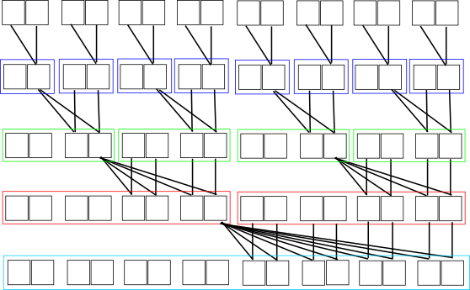
SUMMED AREA TABLE -1D Method used
16 elements
1st step
2nd step
3rd step
4th step

Slide 4
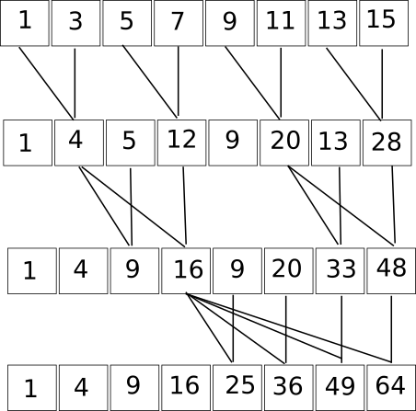
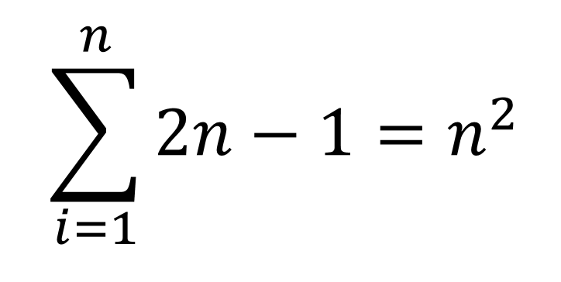

SUMMED AREA TABLE -1D Ex. First 8 odd numbers
We know that for a mathematical property, the sum of the first n odd numbers is n²
That’s why we get the first 8 square number as result
$$\sum_{i=1}^{n}{2n−1=n^{2}}$$

Slide 5
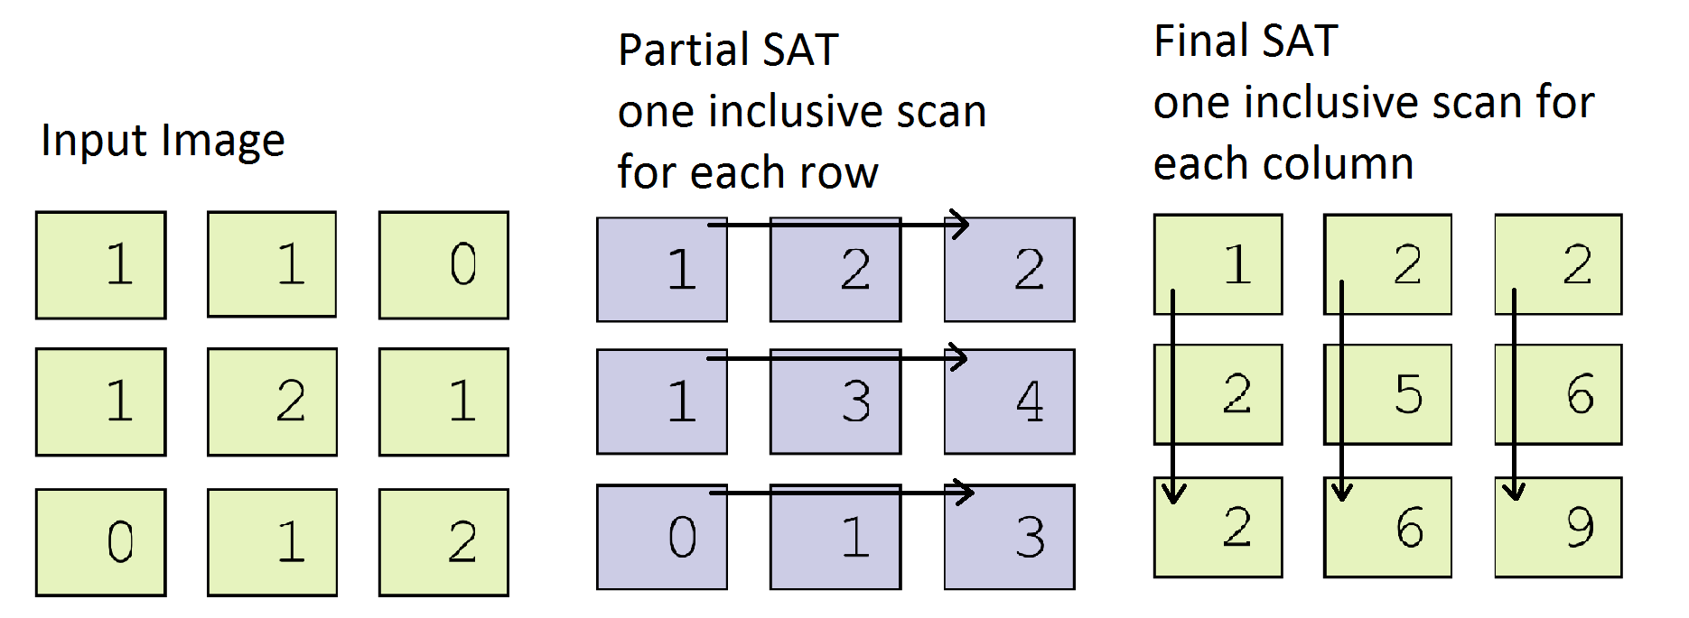
SUMMED AREA TABLE -2D Inclusive scan (on LIM)

Slide 6
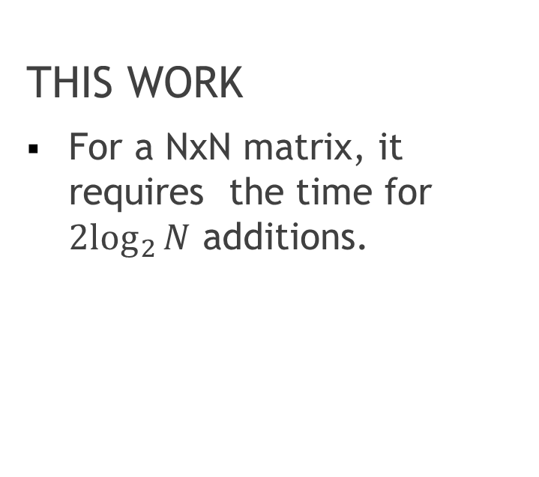
SUMMED AREA TABLE Results
THIS WORK
For a NxN matrix, it requires the time for ${2log}_{2}{N}$ additions.
LIM
For writing the data, for the configuration and the algorithm computation it requires 9N+1 cycles

Slide 7
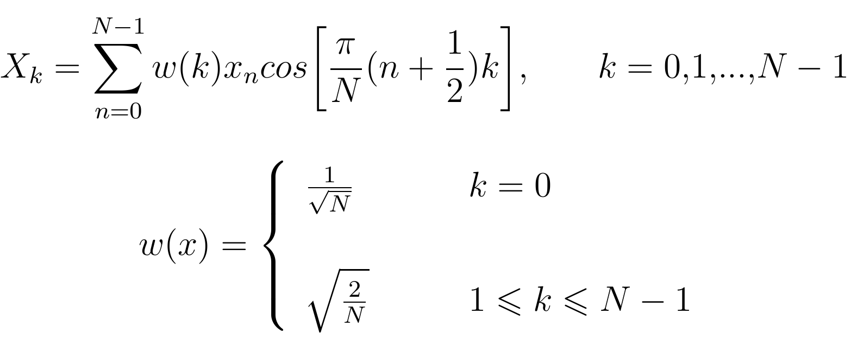
DISCRETE COSINE TRANSFORM
A discrete cosine transform (DCT) expresses a finite sequence of data points in terms of a sum of cosine functions oscillating at different frequencies.

Slide 8
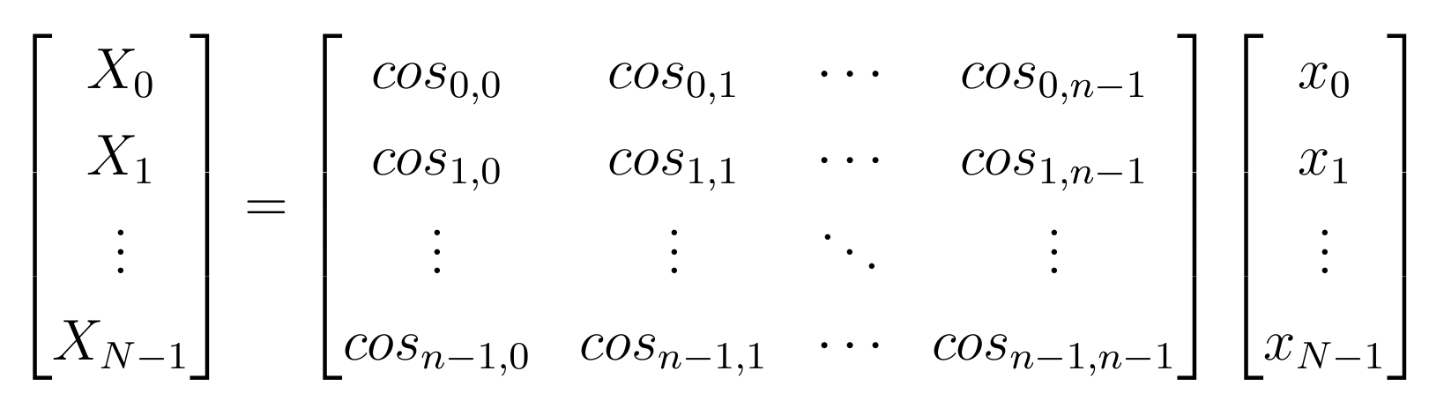
DISCRETE COSINE TRANSFORM

Slide 9
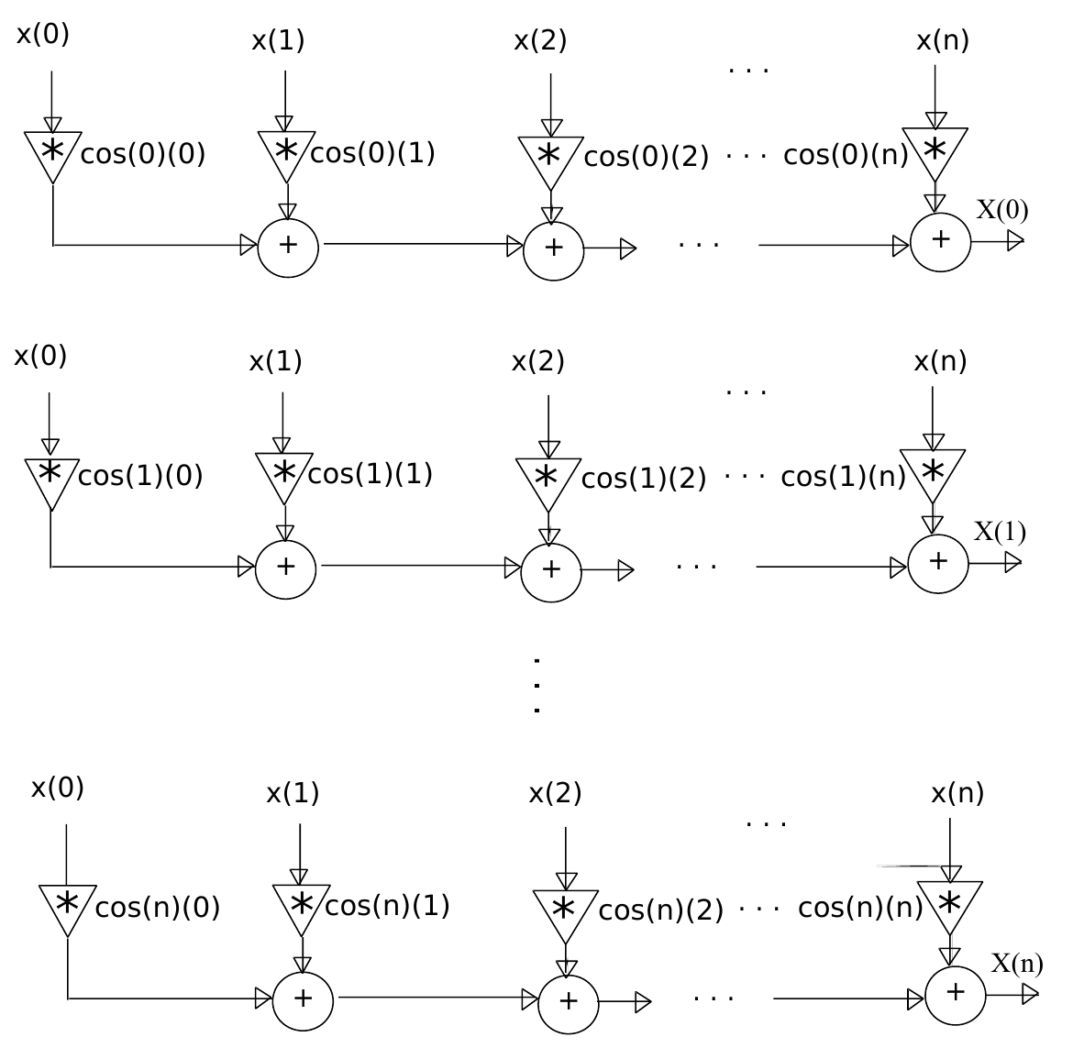
DISCRETE COSINE TRANSFORM Parallelization

Slide 10
DISCRETE COSINE TRANSFORM LLM-DCT optimization
There's a faster DCT algorithm, sometimes called LLM for its authors: Loeffler, Ligtenberg, and Moschytz: for a certain kind of matrix (with size 2^{n}), we can reduce the number of multiplications.

Slide 11
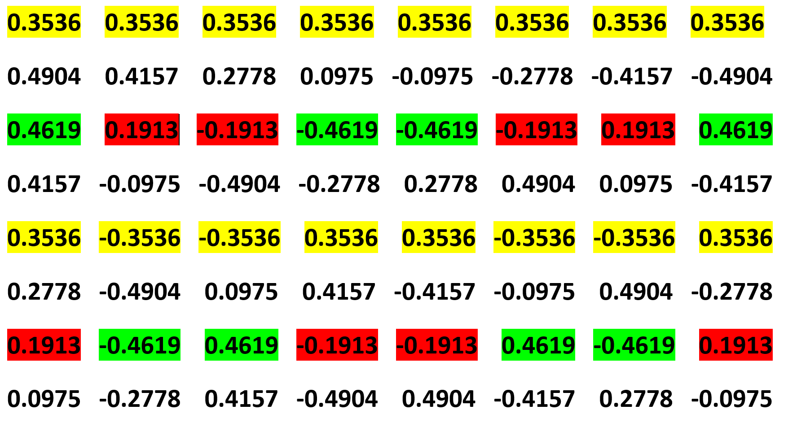
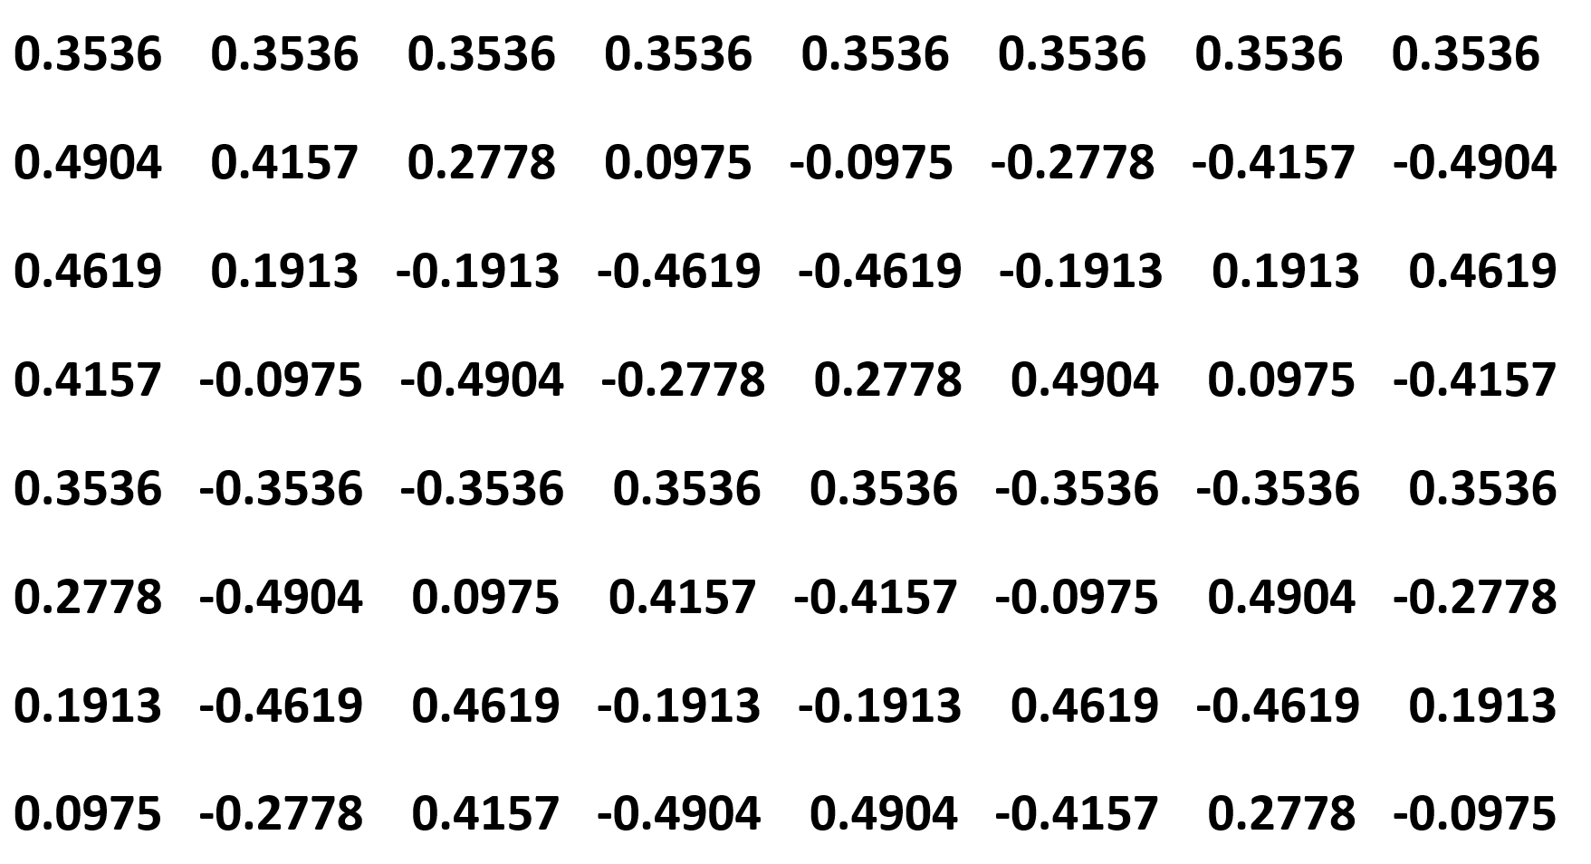
DISCRETE COSINE TRANSFORM Cosine matrix for n=8

Slide 12
DISCRETE COSINE TRANSFORM Cosine matrix for n=8

Slide 13
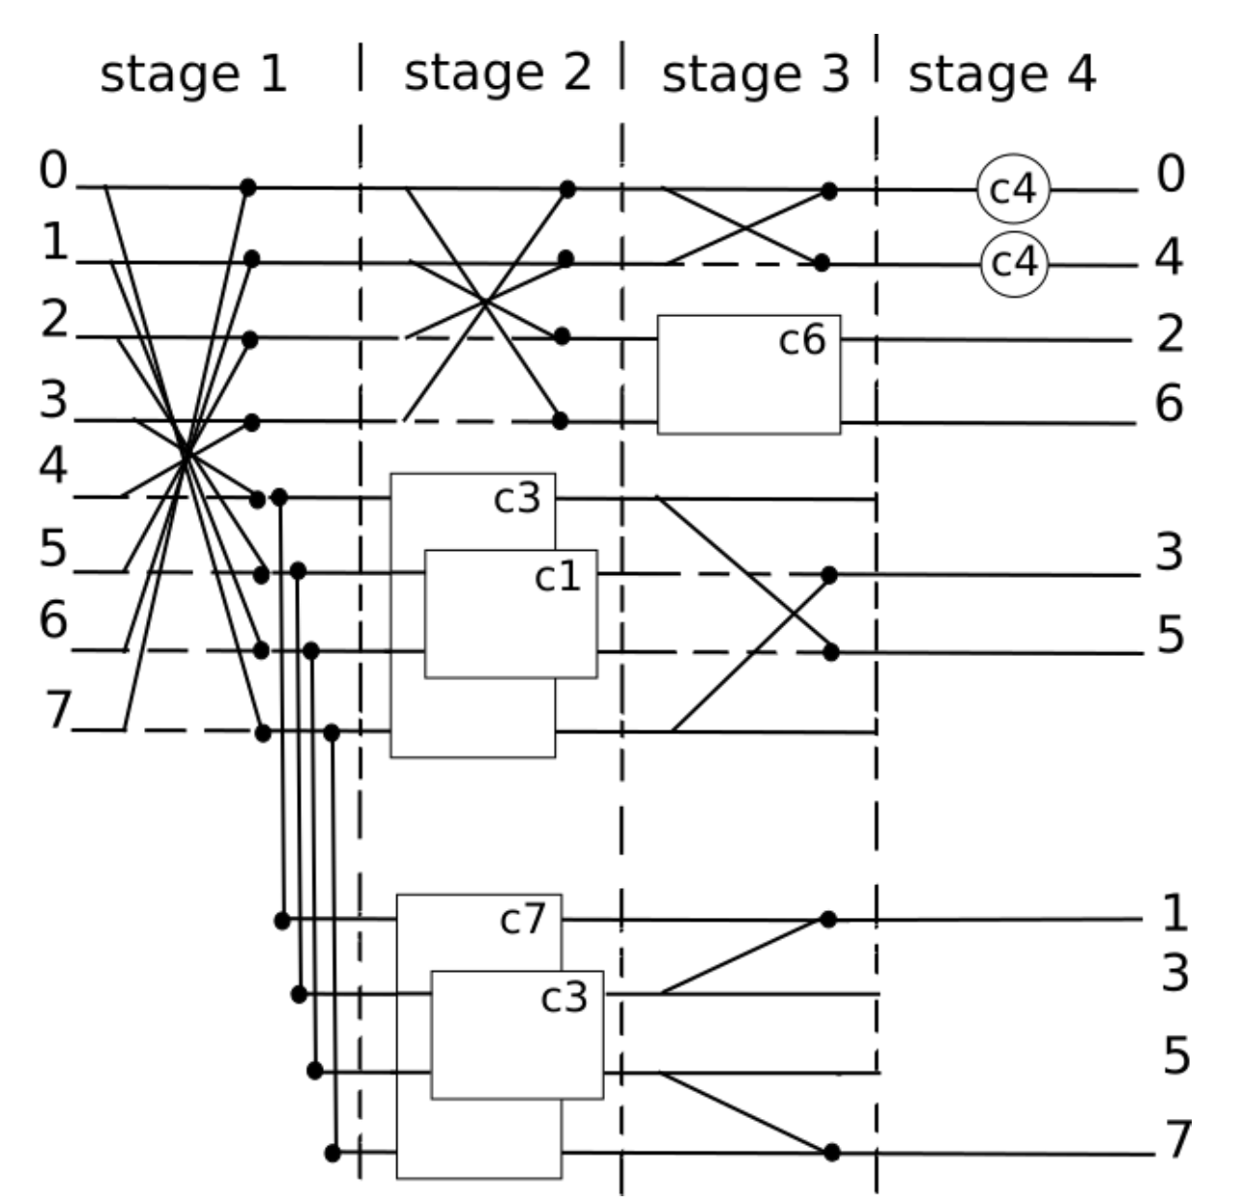
DISCRETE COSINE TRANSFORM LLM 8-DCT implementation

Slide 14
DISCRETE COSINE TRANSFORM Results
THIS WORK
Time required:
-1 multiplication
-N-1 additions
Area:
-NxN multiplier
-NxN adder
SISTOLIC ARRAY
Time required:
(2N-1)x(1multiplication
+ 1 additions)
Area:
-NxN multiplier
-NxN adder

Slide 15
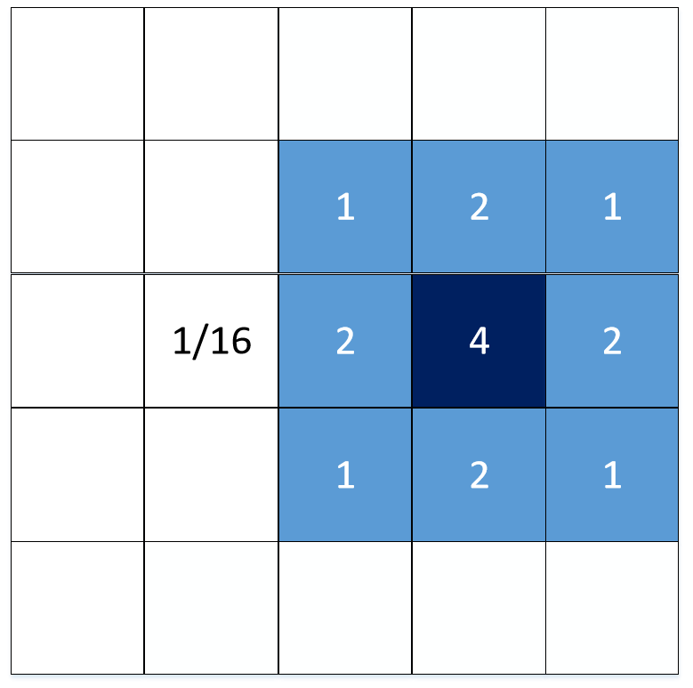
BINOMIAL FILTER
It’s a weighted mean using binomial coefficients between the cell with the neighborhood.

Slide 16
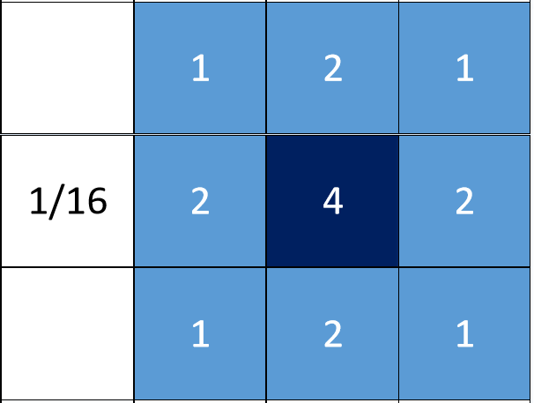
BINOMIAL FILTER Common method
Usually you would compute the Binomial Filter for each cells, which requires 5 multiplications, 8 additions, one divisions.
OVERALL:
-NxNx5 multiplications
-NxNx8 additions
-NxN divisions

Slide 17
BINOMIAL FILTER Optimization 1
No need for a logic to do multiplication and division, just «shift», everything is encoded in binary
Shift left by 1,2, ..n positions → multiply by 2¹, 2², … 2^{n}
Shift right by 1,2, ..n positions → divide by 2¹, 2², … 2^{n}

Slide 18
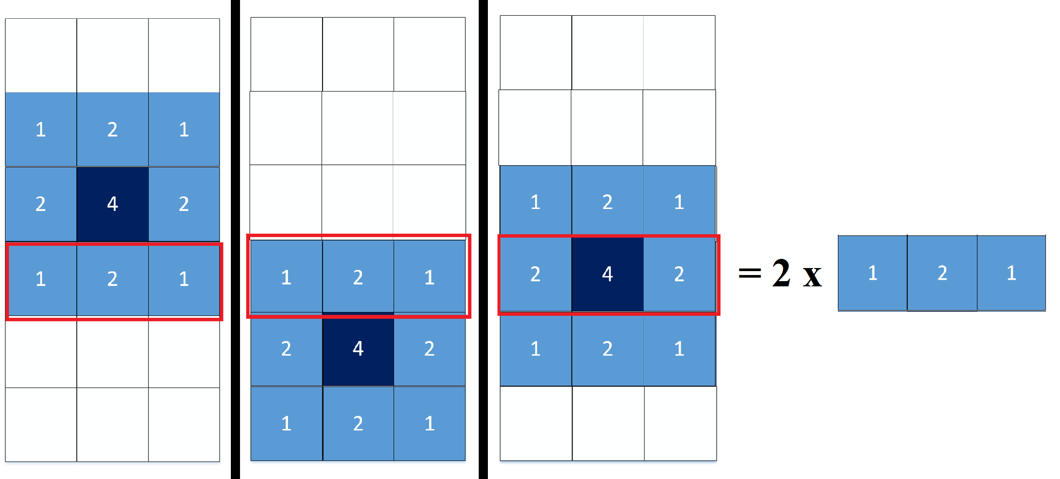
BINOMIAL FILTER Optimization 2
We notice that there are some additions that could be saved into a storage memory and re-used instead of computing 3 times.

Slide 19
BINOMIAL FILTER Results
THIS WORK
No multiplications
No divisions
Approximately NxNx8/3 additions
Time for 4 additions
LIM
NxNx5 multiplications
NxNx8 additions
NxN divisions
Time for 1 multiplication, 8 additions, 1 division

Slide 20
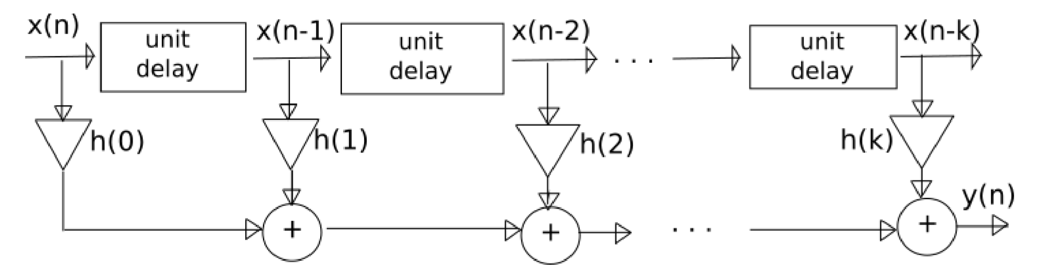
FIR FILTER
The finite impulse response (FIR) filter is called in this way because the filter output is computed as a weighted, finite term sum, of past, present, and perhaps future values of the filter input.

Slide 21
FIR FILTER Results
Time required
-1 multiplication
-N-1 additions
Area
-N-1 registers
-N multiplier
-N-1 adders

Slide 22
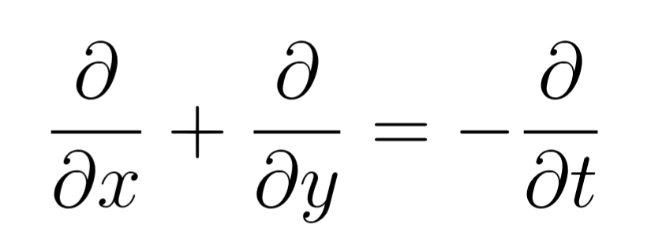
TRAN SPORT EQUATION PROBLEM
The transport equation is a partial diﬀerential equation that describes the distribution of heat (or variation in temperature) in a given region over time.

Slide 23
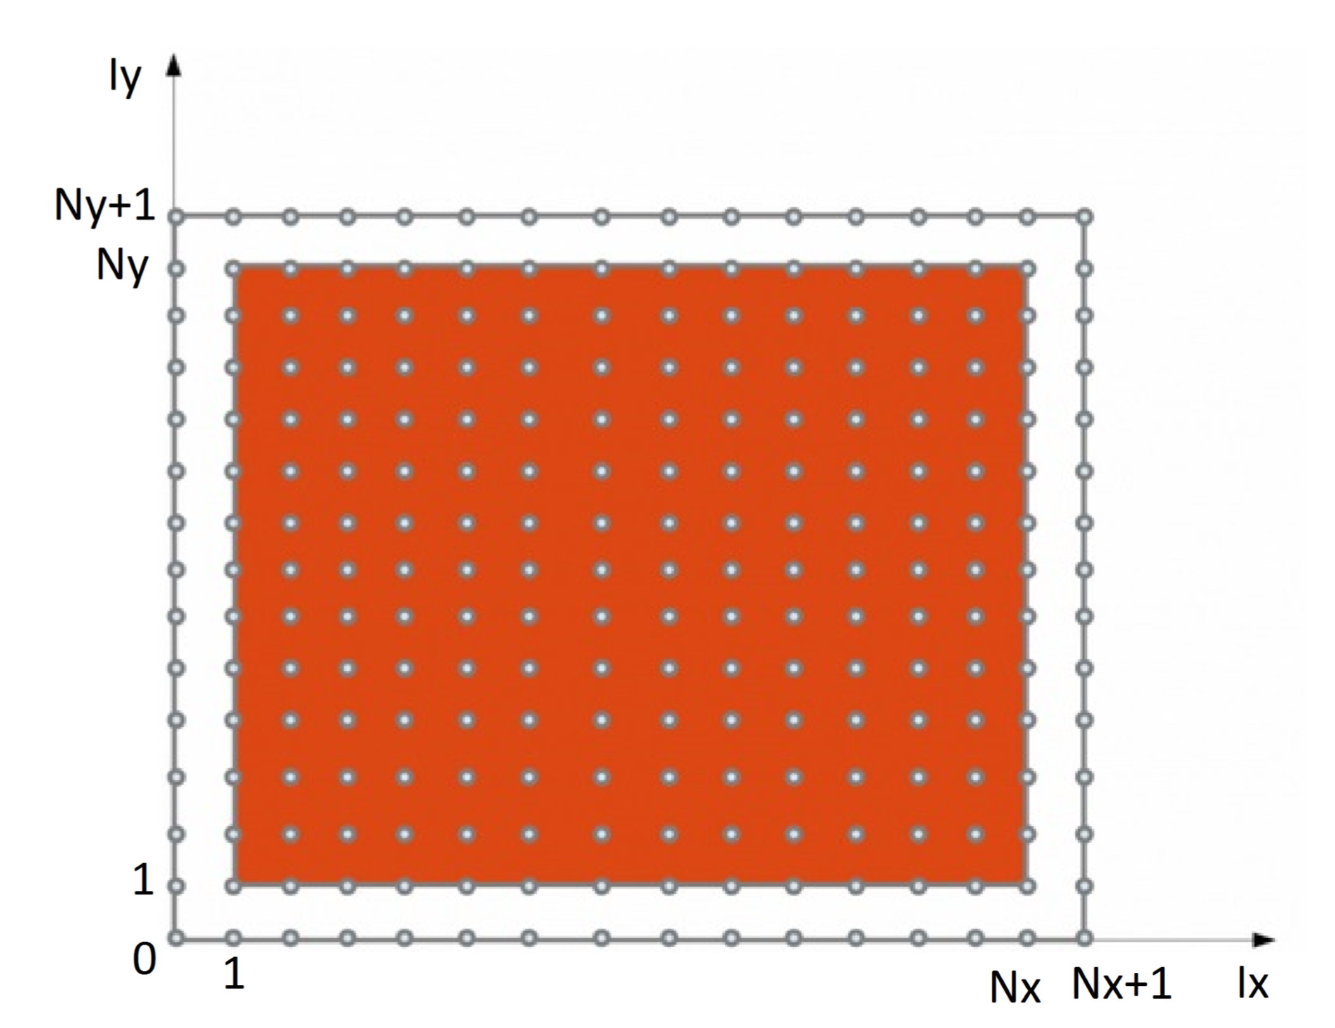
TRAN SPORT EQUATION PROBLEM
Data are evolved along Y=X direction, i.e. towards the up-right corner of the coordinate system

Slide 24
TRAN SPORT EQUATION PROBLEM Results
Each cell perform the equation in parallel because there is no data dependencies between them.
Area: 3NxN adders, NxN substractors, NxN multipliers
Time: Time for one one multiplication and 3 additions

Slide 25
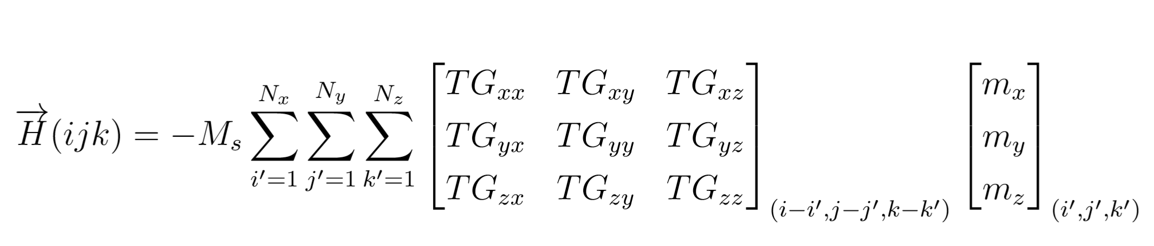
MAGNETOSTATIC FIELD CALCULATION 3D
The magnetostatic ﬁeld is connected to the magnetization through the magnetizing tensor.
The evaluation of the magnetostatic ﬁeld of a given cell requires the summation of all cells of the mesh.

Slide 26
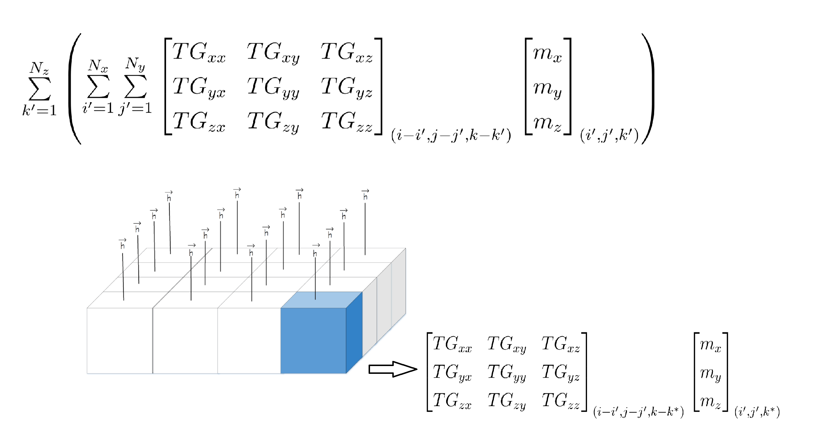
MAGNETOSTATIC FIELD CALCULATION 3D

